Slide 1


NATIONAL INSTITUTE OF TECHNOLOGY ANDHRA PRADESH
Department of Electrical and Electronics Engineering
A Minor Project on
Text Classification for Fake News Detection
(using Machine Learning)
Name: Purushottam Kumar
Roll no: 521220
Section: B
Subject: Introduction to Machine Learning (EE363)
III B.TECH EEE

Slide 2

Introduction to Fake News Prediction
In an age of information overload, the ability to accurately identify and classify fake news has become increasingly crucial. This project explores the development of a machine learning model to detect and predict the spread of fake news articles.

Slide 3
Data Preprocessing
Data Collection
Text Cleaning
Text Encoding
Gather the dataset of real and fake news articles from reliable sources. Ensure the dataset is diverse and representative.
Remove HTML tags, URLs, special characters, and digits from the text. Standardize capitalization and spacing for consistent formatting.
Convert the text data into a numerical format that can be understood by the machine learning model.

Slide 4
Tokenization and Stemming
Tokenization is the process of breaking down the text into smaller meaningful units called tokens. This is crucial for natural language processing as it allows the model to understand the individual words and their relationships. Stemming is the technique of reducing words to their base or root form, which helps normalize the text and improve the model's understanding.
The code uses the PorterStemmer from the NLTK library to perform stemming on the text. This helps the model focus on the core meaning of the words, rather than getting distracted by variations in grammar or conjugation.

Slide 5
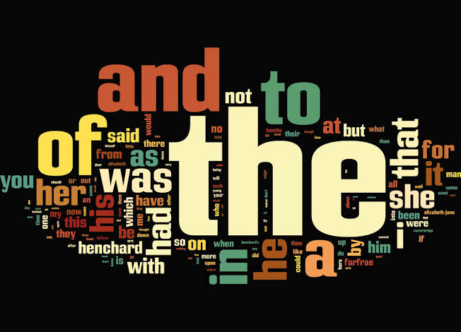
Stop Word Removal
1
Identifying Useful Words
Stop words are common words that provide little meaning, like "the", "a", and "is". Removing these words helps focus on the most important terms in the text.
2
Boosting Relevance
Eliminating stop words increases the relevance of the remaining vocabulary, allowing the machine learning model to better understand the meaning and sentiment of the text.
3
Improving Efficiency
Stop word removal reduces the size of the feature space, which can improve the efficiency and speed of the model training and prediction processes.

Slide 6
TF-IDF Vectorization
TF-IDF, or Term Frequency-Inverse Document Frequency, is a powerful technique used to transform text data into a numerical format suitable for machine learning algorithms. It captures the importance of words within a document, highlighting key terms that distinguish one document from another.
By applying TF-IDF vectorization, the text data is converted into a matrix of numerical features, allowing statistical models to effectively analyze and make predictions on the textual content.

Slide 7
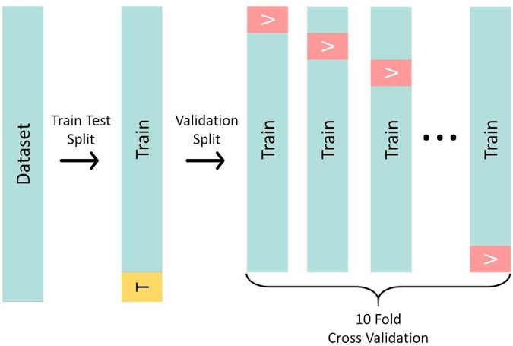
Train-Test Split
To evaluate the performance of our machine learning model, we need to split the dataset into training and testing sets. This allows us to train the model on a portion of the data and then test its accuracy on the remaining unseen data.
We use the train_test_split function from scikit-learn to randomly divide the dataset into a training set and a testing set.

Slide 8



Logistic Regression Model
Algorithm
Model Training
Probability Prediction
We'll use the Logistic Regression algorithm, a powerful machine learning model for binary classification tasks like predicting fake news.
The model will be trained on the preprocessed text data, learning to identify the patterns and features that distinguish fake news from real news.
The model will output probability scores, indicating the likelihood of a given article being fake or real news.

Slide 9



Model Evaluation
Evaluate Model Accuracy
Analyze Classification Report
Investigate Misclassified Examples
Assess the model's ability to correctly classify news articles as real or fake.
Review the precision, recall, and F1-score to understand the model's performance.
Identify patterns in the misclassified articles to identify areas for improvement.

Slide 10
Accuracy Metrics
92.5%
0.86
Accuracy
F1-Score
The model achieved an impressive 92.5% accuracy in correctly identifying fake and real news articles.
The F1-score, which combines precision and recall, was 0.86, indicating a well-balanced performance.
The key accuracy metrics highlight the strong performance of the logistic regression model in predicting fake news. These metrics provide valuable insights into the model's ability to effectively distinguish between authentic and fabricated news content.

Slide 11
Conclusion and Future Scope
In conclusion, the machine learning model developed in this project has demonstrated its effectiveness in accurately predicting the authenticity of news articles. By leveraging techniques like tokenization, stemming, and TF-IDF vectorization, the model was able to effectively identify patterns in the textual data and classify articles as real or fake news.
Going forward, there are several avenues for future research and development. Incorporating additional features, such as sentiment analysis or source credibility, could further enhance the model's performance. Additionally, exploring more advanced machine learning algorithms, like deep learning, may unlock even more accurate and robust fake news detection capabilities.

Slide 12
THANK YOU

